Slide 1
State Accounting Business User Group (BUG)
Tuesday, May 25, 2021
9:00 AM – 11:00 AM
WebEx only

Slide 2
Agenda
Announcements & Reminders
Presentations
Welcome
Send questions through WebEx chat
Update to miscellaneous items
Deactivation of user IDs upon employee termination
Requests for State Accounting
Fiscal Year End Schedule
SEFA (Schedule of Expenditures of Federal Awards)
Financial Reporting Package
Fixed Assets, Construction in Progress and Construction Commitments
Biennial Carryover reports

Slide 3
Statute 81-1174 2(b)
Notes:
For the first point, a service purchase order is not valid and will need to be received, closed out or cancelled prior to FEYE

Slide 4
Object codes
571100 | LODGING | Costs of lodging accommodations incurred while in travel status for the State.
571600 | MEALS – TAXABLE | Expenses related to meals for individuals when not in travel status to attend official functions, conferences, hearings, and/or same day travel meal reimbursements. All are subject to being considered a taxable benefit when the value of meals received exceed $200 for a twelve-month period.
571800 | MEALS – TRAVEL STATUS | Meals reimbursed on a Per Diem basis while in travel status
Notes:
When cancelling a PO, it will ask if you are sure…choose Yes. Then it will bring up a screen for you to leave a comment on why PO is being cancelled. You will still need to save after this.

Slide 5
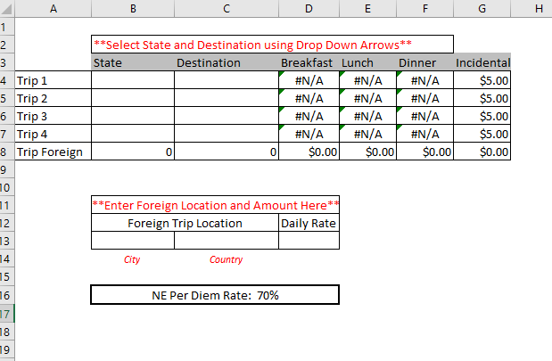
Notes:
When cancelling a PO, it will ask if you are sure…choose Yes. Then it will bring up a screen for you to leave a comment on why PO is being cancelled. You will still need to save after this.

Slide 6
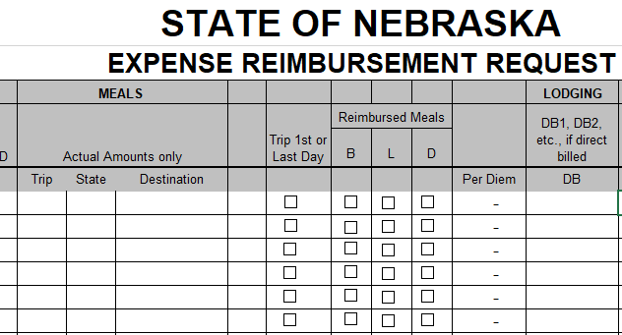

Slide 7
Definition of Terms
Per Diem: The allowance for meals (including tips) and incidental expenses. The State per diem base rate is calculated from the General Services Administration (GSA) rate.
Incidental Expenses: Federal Travel Regulation describes these only as: fees and tips given to porters, baggage carriers, hotel staff, and staff on ships.
Group Meal: Official functions, conferences, or hearing only. Attendees could include state employees who are in travel status, state employees who are not in travel status, and/or non-state employees. The meal would be reimbursed for the actual expense, and must be paid on a state purchasing card.

Slide 8
Destination City: The main location of your travel. This city will be used for the calculation of per diem meals for the entire trip.
International Travel: Use the specific ERD form for Foreign Travel. Meal per diem rates can be checked by using this link - https://aoprals.state.gov/web920/per_diem.asp
GSA Per Diem Rates: Link to view the rates for travel within the contiguous United States - https://www.gsa.gov/travel/plan-book/per-diem-rates
Link to view rates for travel within Alaska, Hawaii, or a US territory - https://www.defensetravel.dod.mil/site/perdiemCalc.cfm
Headquarter City: The location of your office
Immaterial Items: Expenses incurred for less than $10.00.

Slide 9
ERD Training Video https://youtu.be/tQJmOdlF0iA
Travel Examples covered in training:
Out of State Conference
Out of State Training
Multiple Day Travel in Nebraska
One Day Travel
International Travel

Slide 10
Other Expense Reimbursement Items
Miscellaneous expense
Uber/Taxi tips
Provided breakfast
When in overnight travel status, a hot breakfast with protein is provided, teammates cannot claim breakfast

Slide 11
Financial Reporting
Industry changing the name of the report:
Old – Comprehensive Annual Financial Report
New – Annual Comprehensive Financial Report (ACFR)
Governmental Accounting Standards Board is encouraging early adoption of the change
We will adopt the title change for 2021

Slide 12
Announcements
Deactivation of user IDs upon employee termination
http://das.nebraska.gov/personnel/user_guides/ewoc/terminateanemployee.pdf
Workday
Needs to be done right away for security purposes, this has been an audit finding for several years

Slide 13
Announcements
Requests for State Accounting
Always send requests through as.stateaccounting@nebraska.gov
If you are used to working with a specific person you are welcome to cc them
Requests that are sent only to a specific teammate could easily get missed or delayed

Slide 14
Questions?

Slide 15
Fiscal Year End Schedule
Sheryl Hesseltine

Slide 16
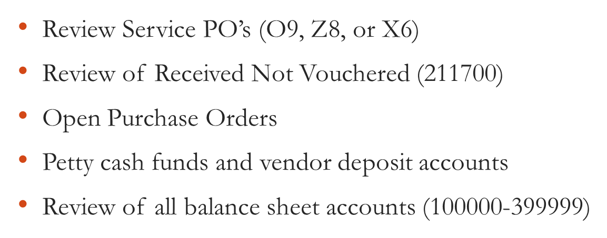
Tuesday, June 1, 2021
Review open manual encumbrances

Slide 17
Thursday, June 10, 2021
Bi-weekly payroll (B12) due for certification

Slide 18
Monday, June 21, 2021
June monthly payroll due for certification

Slide 19
Thursday, June 24, 2021
Bi-weekly payroll (B13) due for certification

Slide 20
Friday, June 25, 2021
Procurement roles will be taken away at 5:00 PM
Unposted Fixed Asset Report
Fixed Asset No Cost Integrity Report
All Service PO’s (regardless of PO type, a service not received by 6/30 should not be encumbered)
Manual Encumbrances from prior year - liquidate
Allotment Status Report
Review any outstanding cash transactions related to the Treasurer’s office
LAST DAY TO POST FISCAL YEAR END 6/30/21 TRANSACTIONS

Slide 21
Monday, June 28, 2021
Treasurer’s Office opens for normal business transactions.
No purchasing activity without authorization from Materiel. Do not perform a receipt function against an outstanding purchase order for current period or a future period unless authorized since these must be posted before year-end.
Only volume voucher payments and emergency payments.
Line Type 4 – vouchers with July 2021 GL dates, do not adjust voucher amount until July
Legally required expenditures for E1 Fiscal Year 20 (July 1, 2020 to June 30, 2021) will be allowed to post only with prior notification and approval by State Accounting

Slide 22
Tuesday, June 29, 2021
Treasurer’s Office open for normal business transactions
Only volume vouchers and emergency payments
Legally required expenditures for E1 Fiscal Year 20 (July 1, 2020 to June 30, 2021) will be allowed to post only with prior notification and approval by State Accounting

Slide 23
Wednesday, June 30, 2021
Treasurer’s Office cut off for deposits – 9:00 A.M.
No purchasing or posting activities
If there are outstanding issues for your agency that will have a financial impact, contact Sheryl Hesseltine by 12:00 P.M.
E1 will be shut down for all agencies at 3:00 P.M.
Outstanding purchase orders (not received) will be rolled over to the new fiscal year

Slide 24
Thursday, July 1, 2021
NO POSTING UNTIL FLASH MEMO IS RECEIVED THAT YEAR END CLOSE IS COMPLETE – ANTICIPATED BY THURSDAY, JULY 1, 2021 AT 7:00 A.M.
First allotment of new fiscal year appropriations provided by Budget Division
Prior year voucher processing when appropriate
July 1, 2021 Allotment Status Report will be available on MREPORT
Review open Purchase Orders to be sure rollover is correct

Slide 25
Friday, July 2, 2021
Prior year manual encumbrances that were voided (to be carried over) may be re-entered
Start entering valid manual encumbrances
Encumbrance Detail Report

Slide 26
Thursday, July 15, 2021
State Accounting will calculate accrued payroll based on July 14th biweekly payroll
July 14th payroll is 80% June hours
Contact State Accounting if you use a different method or have questions

Slide 27
Friday, July 30, 2021
Complete entry of E1 Fiscal Year 21 (July 1, 2021 to June 30, 2022) budgeted amounts for the Budget Status Report

Slide 28
Biennial Carryover Reports
First draft as of 7/31/21 – run on Monday, August 2, 2021
Second draft as of 8/13/21 – run on Monday, August 16, 2021
Certified version as of 8/31/21 – run on Wednesday, September 1, 2021
Certified Biennial Carryover Report (signed copy) due to State Accounting by Friday, September 17, 2021
Blank reports must be sent in as well

Slide 29
Thursday, September 30, 2021
State Budget division completes review of certified encumbrances
Re-appropriation provided as appropriate
After certification process completed, State Accounting will liquidate payroll encumbrances that we entered

Slide 30
Questions?

Slide 31
Financial Reporting Package
Chad Pinger

Slide 32
Financial Reporting Package
Documents to be sent to all agencies first week of July
Response due by August 13, 2021
Send to AS State Accounting or Chad Pinger

Slide 33
Financial Reporting Package
Potential Forms to be Completed
Accruals
Leases
Cash & Investments
Construction In Progress (CIP)
Construction Commitments
Non-Monetary Transactions
Irrevocable Split Interest Agreement
Service Concession Arrangements

Slide 34
Schedule of Expenditures of Federal Awards
Chad Pinger

Slide 35
Schedule of Expenditures of Federal Awards (SEFA)
Annual Review included in Statewide Single Audit
Tracking Expenditures by Federal CFDA #s
Funds sent to another agency should use Object Code 594100
Funds received from another agency should use Object Code 461500

Slide 36
Schedule of Expenditures of Federal Awards (SEFA)
Agencies who receive Federal funds will get an email from State Accounting the first week of July. A report from E1 will be included
Verify the amount of Federal expenditures and sub-recipient expenditures for each federal award (CFDA#)
Any differences need to include a brief description
Response due back August 9th, 2021 to Chad Pinger

Slide 37
Questions?

Slide 38
Fixed Assets
Kevin Le

Slide 39
Procurement
Planners: setting stage with PO creation
Detail lines most important:
Single or multiple items
Fixed Asset object code “58”
Payees:
3 way match and O Batch
(let this post before PV!)
Creates first relationship with Fixed Assets & G/L
Adds transaction to Unposted FA report
Accounting
Fixed Assets
Foundation of the asset (multiple people)
Create the Asset Masters
Monthly review of Unposted FA Transaction report & FA No Cost Integrity report
Post costs to Assets
Notes:
The 3 Pillars of an asset:
Procurement: Single or Multiple PO lines: single line-easy post for FA, one line with multiple items will be a FA split to assign costs to each item
Accounting: starts with receipting of the PO. Receipting PO creates OV batch, make sure this has posted before the PV batch is created.
Fixed Assets: begins with creating the Asset Master

Slide 40
Creating an Asset Master

Slide 41
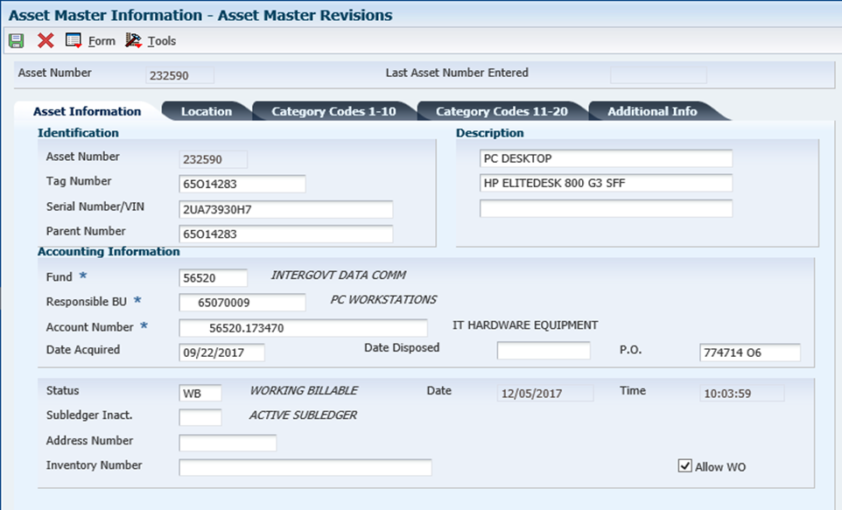
The Fixed Asset tag number should match the agency and division. The tag number should also match the responsible business unit.
(In this example, agency 65)
Fund:
Not sure? Skip to responsible BU, use magnify glass to search for fund paired to BU.
Account #: fund # and 17xx00
xx=from digits 3 & 4 in the OC
Ex. 65070009.583470
Acct # for FA= 56520.173470
Remember to enter PO #
Notes:
Start with FA Tag #
How to find fund
Acct #-how to find. Next slide-why is this important?

Slide 42
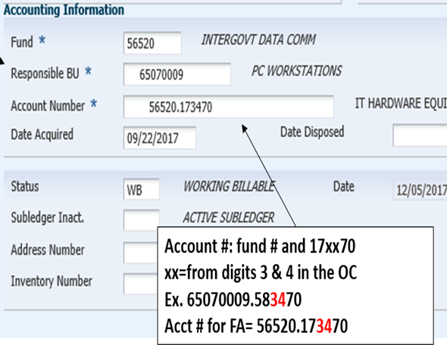
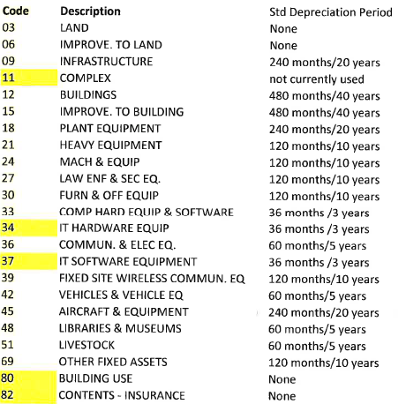
Notes:
Within the Acct #, #’s 3 and 4 relative to 2 parts of the asset *Depreciation-see coding
*Item Code-next slide

Slide 43
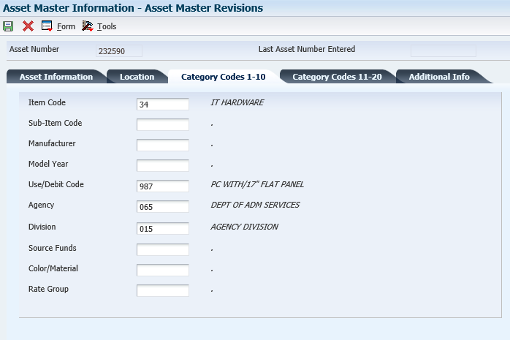
Item Code: auto filled from the Asset info tab
Both must be entered

Slide 44
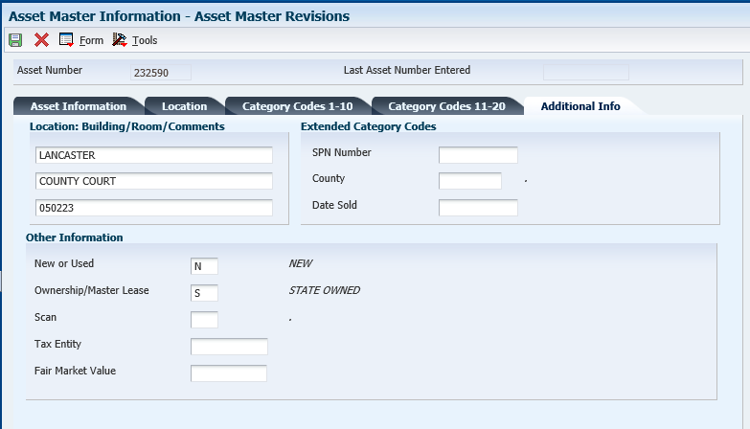
Both fields should be entered
Notes:
Save Asset Master. E1 will then auto assign an asset # to the TAG you just created.
More details in the E1 training guides

Slide 45
Fixed Asset Reports

Slide 46
Unposted Fixed Asset Report
Review all transactions which have been posted in the General Ledger, but have not yet been posted to a fixed asset
(shows OV receipt batches and PVs vouchered without PO using 58**** object, used for JE entry reference)
Simply: costs coded to fixed asset object code
& have been receipted or entered as JE
June 24, 2021 – All unposted Fixed asset need to be posted.

Slide 47
Notes:
Two receipts, OV batches, posted to report

Slide 48
Fixed Asset No Cost Integrity Report
Review any assets that are missing costs.
Goal is to have this report blank, kept as short as possible, and with only recently acquired assets
Simply: asset master has been created, but no costs are attached

Slide 49
Notes:
If you discover that this report has multiple assets listed, it is possible that an error may have occurred. Ex. Cost might have been “passed” on, and not posted to the asset. Need to review the Asset Master Record, and purchase order to determine if costs need to be posted.
*The F/A No Cost Report & Unposted FA Report should be reviewed monthly. Unposted FA should be cleared at end of every month.

Slide 50
Posting Costs to an Asset

Slide 51
State of NE -> Fixed Assets -> Post Fixed Asset Transactions-> Revise Unposted F/A Entries
Doc #: found on Unposted Fixed Asset report, part of the OV batch
Add Tag # to asset
Row - Revise entries-enter Tag # and save
Final Step: Row -> Post -> Save
Notes:
*Master Asset Record must be created before you can post the cost to the assets.
*Doc number from Unposted Fixed Asset report, will pull up receipt entry.
*Row, revise entries to add tag # to entry
**Row, Post, and Save.
Hit hourglass to refresh this screen, your unposted should disappear.

Slide 52
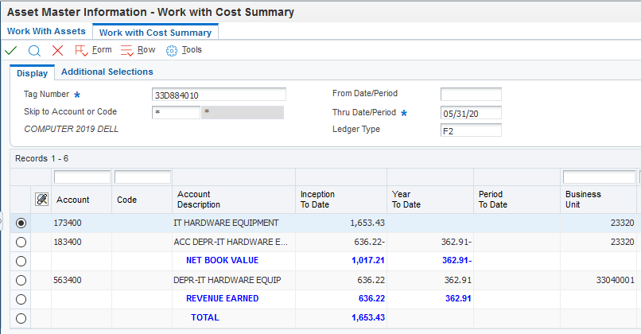
Asset Master-> Asset Balance Info -> Cost Summary
Notice account #’s- both list the “34”
Value of asset posted
Notes:
This is what your asset should look like in E1 when cos

Slide 53
Split Asset Transaction
Doc #: found on Unposted Fixed Asset report, part of the OV batch

Slide 54
Amts. should balance when you hit “save” after all entries
Import excel sheet for multiple entries
Add Tag # to each line

Slide 55
Posting costs to an asset need to be completed within the same month as the receipt if it is being split.
If they are not, a JE must be completed in order to post the costs
Allow ample time between receipting and posting costs to fixed assets
Ex. 5 days before month end, do not receipt any fixed assets!

Slide 56
Fixed Assets: prior month cost posting
Compare the “Fixed Asset No Cost Integrity” report & “Unposted Fixed Asset” report.
Find the cost on the “Unposted Fixed Asset” report (this is an “OV” receipt batch) that aligns with “Fixed Asset No Cost Integrity” report tags.
Notate the document # on the “Unposted Fixed Assets” report

Slide 57
JE approved and posted
Run Unposted Fixed Asset report, and note the document # related to your JE
E1 String:
State of Nebraska>Fixed Assets>Post Fixed Asset Transactions>Revise unposted fixed asset entries
Enter document # from the new Unposted Fixed Asset report, search.

Slide 58
Step 1: Select all DR entries; these costs will be posted.
Row->Post
Tag #’s should be listed here, if not, verify that an Asset Master was created
Step 2: Select CR tab.
Row->revise entry.
Notes:
Once the Dr have been posted, refresh screen. Only CR should show.

Slide 59
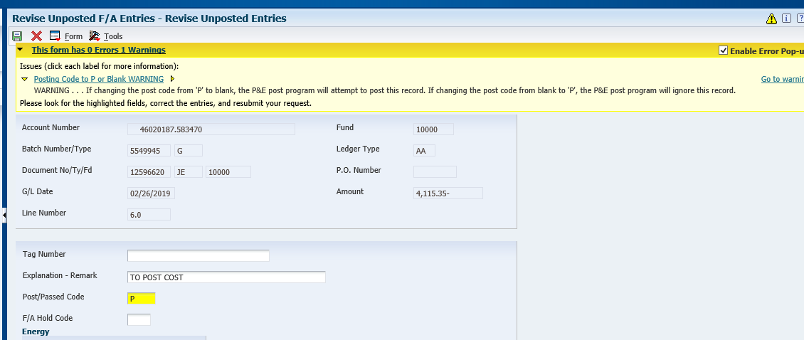
Notes:
When passing on CR, yellow message box appears,
If changing from “blank” to “P” E1 will ignore this record. OK to hit OK again, this is what we want it to do.

Slide 60
Original Unposted fixed asset report, locate the original OV doc #, that was created when the PO was receipted against.
Using the Revise Unposted FA Entries screen, pull up the original OV doc #. Pass on these costs. Notate in description reason for passing on costs.
This will remove the OV receipt entries items from the unposted FA report.
The JE that was created to post costs to the asset replaces the OV Receipt. This is why we are passing on the costs.

Slide 61
Oops! I posted both my DR and CR transactions, now what?
If you accidentally zero out the costs for your fixed asset, by selecting the debit and credit row, then you’ll need to create a new journal entry since the amounts are now zeroed out. State Accounting CANNOT undo this mistake if you post the costs incorrectly. You will have to complete a NEW journal entry.

Slide 62
Summary
Fixed Assets have a direct relationship with Procurement and Accounting functions
Asset Master must be created before costs posted to asset
Post the cost in the same month that the PO is receipted if it needs to be split.
“Split” FA Transactions for multiple items, 1 PO line
Previous month not posted, JE entry
June 24, 2021 date when All unposted Fixed assets need to be posted
Monthly review of Unposted FA report, FA No cost integrity report and Received not vouchered.

Slide 63
Construction in progress
Projects of $100,000 or more with multiple progress payments in more than one fiscal year that need to be capitalized
Sent out with Financial Reporting packages
Complete this form if your agency has projects that meet the reporting requirements for Construction-In-Progress
Agencies that have reported CIP from the previous year will receive the form with projects still in progress including a beginning balance
Create Fixed Asset Tags for CIP projects that were substantially completed during the year. Complete before June 24, 2021.

Slide 64
CIP
Substantially Completed:
Buildings - when people are moving in and using the building.
IT projects - when production environment is being used.
Payment of final invoices and retainage can be added to the tag after the substantially completed date.

Slide 65
Phases of an Application Software Project
Phases: General treatment of costs:
Preliminary Project Stage - Expensed
“Preliminary Project Stage” means the earliest stage of a software development or selection project, during which the alternatives are being evaluated but no decision has been made as to which strategy or vendor to use. Typical activities during this phase include assembling the evaluation team, evaluating proposals from vendors and the final selection of alternatives.
Application Development Stage - Capitalized
“Application Development Stage” means the stage of a software development or selection project during which the design, coding, installation and testing of new software occurs. The stage begins once management has authorized and committed to funding the project, and it is considered probable that the project will be completed and put to its intended use. The application development stage concludes when the software is complete and ready for use.
Post Implementation/Operation Stage - Expensed
“Post-Implementation/Operation Stage” means the stage that begins once the software is put into use. It includes training and subsequent maintenance of the software.

Slide 66
Construction Commitments
Projects of $100,000 and over, that are under contract
For each project, please provide the percentage of remaining contract balance by funding source
Form will be sent out with Financial Reporting package.

Slide 67
Questions?

Slide 68
O Batches
Shannon Muffly

Slide 69
Unposted O Batches
If O batch is in error status, only State Accounting can reverse and delete
Email AS.stateaccounting@nebraska.gov
If O batch has posted, agency can post a reversal
Remember that a reversal creates a new batch and needs to be posted as well
Do NOT voucher unless O batch has posted

Slide 70
Biennial Carryover Reports
Shannon Muffly

Slide 71
Biennial Carryover Reports
First draft as of 7/31/21 – run on Monday, August 2, 2021
Second draft as of 8/13/21 – run on Monday, August 16, 2021
Certified version as of 8/31/21 – run on Wednesday, September 1, 2021
Certified Biennial Carryover Report (signed copy) due to State Accounting by Friday, September 17, 2021
Blank reports must be sent in as well

Slide 72
Biennial Carryover Reports
Email your Certified Biennial Carryover Reports to me:
Shannon.muffly@nebraska.gov
If you can’t email, mail them to us with Attention: Chad Pinger. Note our new office:
1526 K Street, Suite 190 (68508-2741)
Please make sure to keep a copy.

Slide 73
Questions?

Slide 74
Questions?
http://das.nebraska/accounting
Administrator’s Correspondence; closing schedule
Accounting Policies; state accounting manual (section 11, encumbrance policy)
http://www.nebraskalegislature.gov/laws/browse-statutes.php
statutes 81-138.01 – 81-138.04
Contact Info
Sheryl.hesseltine@nebraska.gov, 402-417-5038
Shannon.muffly@nebraska.gov, 402-405-1041
Chad.pinger@nebraska.gov, 402-416-1535
Kevin.le@nebraska.gov, 402-432-3784

